Slide 1
Australian Teacher Performance and Development Framework
Building an effective performance and development culture
Notes:
Purpose
To familiarise the Australian education community with the Australian Teacher Performance and Development Framework.
To emphasise the importance of creating a strong performance and development culture.
To explore the components of culture outlined in the Framework.
Key points to share
AITSL has collaborated with education stakeholders to develop the Australian Teacher Performance and Development Framework.
Through national consultation on implementation the conversation in education has begun to build on creating a culture that values the performance and development of teachers, and generation of an effective environment for the implementation of effective teacher performance and development practices across the nation.
The Framework recognises that schools operate in different contexts and will be at different starting points, and the implementation of these essential elements will look different in different contexts. The pace and method of implementation of the Framework will be determined by jurisdictions, sectors and schools.
Expected outcomes
Build a shared understanding of the importance of a strong culture in successful approaches to teacher performance and development.
Materials required
All resources are available at http://www.newsroom.aitsl.edu.au/blog/framework-support-materials
All participants will require copies of:
Australian Teacher Performance and Development Framework (the Framework).
The presentation will be enhanced if participants have access to the following additional Framework resources:
The Framework Discussion Wheel – printable desktop stimulus resource
The Framework Activity Cards – stimulus questions to generate discussion
The Framework Fact Sheet – Animation style
The Framework Infographic – Animation style
The Framework Frequently Asked Questions.
Companion documents :
Australian Professional Standards for Teachers (the Standards)
Australian Professional Standard for Principals (the Standard)
Australian Charter for the Professional Learning of Teachers and School Leaders (the Charter).

Slide 2
The Framework Overview
Click image to play
Notes:
Purpose
To introduce the Framework in an engaging format, exposing participants to different points of view, including that of peers and students.
Key points to share
As discussed in the introduction (slide 1) AITSL has collaborated with education stakeholders to develop the Australian Teacher Performance and Development Framework. The Framework has been developed based on research, national mapping and analysis of existing practices, advice from national and international experts, and national consultation.
The infopromo (informational promotional) video was produced in partnership with schools across Australia.

Slide 3
Australia aims to be a world leader in education
Notes:
(Note to facilitator: this slide features in all of the Framework workshop presentations so you may choose to leave it out if you are utilising all of the presentations.)
Purpose
To highlight that Australia is positioning itself to be a world leader in education.
Key points to share
The Melbourne Declaration on Educational Goals for Young Australians makes clear that Australia aspires not to be among the best in the world, but to be the best. It acknowledges the challenges and opportunities of the 21st century and provides two simple, but powerful, goals to guide Australian education:
Goal 1: Australian schooling promotes equity and excellence.
Goal 2: All young Australians become:
successful learners
confident and creative individuals
active and informed citizens.
The national education reform agenda has resulted in the following policies which demonstrate a consistent approach in all jurisdictions for all teachers across the country including, but not limited to, the following:
Australian Professional Standards for Teachers
Australian Professional Standard for Principals
Accreditation of Initial Teacher Education Programs in Australia: Standards and Procedures
Nationally Consistent Registration of Teachers in Australia
Certification of Highly Accomplished and Lead Teachers in Australia
Australian Teacher Performance and Development Framework
Australian Charter for the Professional Learning of Teachers and School Leaders
National Plan for School Improvement
The Australian Curriculum
National Quality Framework for Early Childhood Education and Care
Early Years Learning Framework and National Quality Standard.
Research
‘Over the next decade Australia should aspire to improve outcomes for all young Australians to become second to none amongst the world’s best school systems’ (MCEETYA 2008, p 5).
‘Together, all Australian governments commit to working with all school sectors and the broader community to achieve the educational goals for young Australians’ (MCEETYA 2008, p. 10).

Slide 4
Unpacking culture in the Framework
A successful approach to teacher performance and development relies on a strong and supportive culture in a school.
Notes:
Purpose
To highlight that culture is the key to enable effective teacher performance and development to flourish in schools.
Key points to share
A focus on student outcomes – Improving teaching is not an end in itself. It is directed at improving outcomes for students.
A clear understanding of effective teaching – The Australian Professional Standards for Teachers provide the basis and a common language for coming to a shared understanding of what effective teaching looks like in the context of a particular school at a particular time.
Leadership – A truly effective approach to performance and development is characterised by a shared commitment to improvement and an acceptance that teachers have a powerful role to play in each others’ development, as well as their own.
Flexibility – The Framework describes the elements of an effective approach to teacher performance and development, but acknowledges that these elements will look different in each school.
Coherence – Performance and development processes and teacher goals should reflect the overall approach to teaching and learning within a school, and should be consistent with the school and system plans and initiatives.
The Framework highlights what is required to build a comprehensive and effective approach to high performance and development.
It outlines the characteristics of a successful system and the culture that needs to be in place for sustained improvements to occur in schools.
Research is unambiguous in showing that a successful approach to effective performance and development relies on creating a strong and supportive culture in a school.
Formal performance and development procedures are important but excessive attention to process is a common feature of less successful approaches. It is therefore important to focus on the factors that need to be in place for a performance and development culture to flourish.
Research
‘To introduce and sustain an effective school-based performance and development system, a culture must exist among school leaders and teachers that is open to feedback and serious about performance and development — that is, a culture that sees performance management as much more than ticking boxes and development as much more than gaining credentials’ (Kamener, L 2012, p. 5).
‘The need for such a culture to exist makes it very difficult simply to impose a performance and development system from the centre, however close such a system might be to best practice’ (Kamener, L 2012, p. 5).

Slide 5
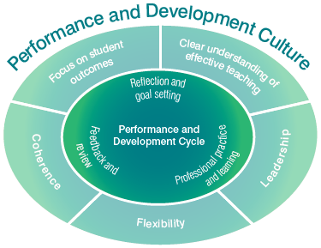
Performance and development cycle
Reflection and goal setting
Professional practice and learning
Feedback and review
Notes:
Purpose
To illustrate the elements of an effective performance & development cycle that operate within the culture.
Key points to share
Elements of the cycle are interwoven, will not necessarily occur in order and may take more or less time depending on circumstances. However, the cycle provides a useful way of thinking about the process, and assists in identifying its important elements.
Reflection and goal setting – To engage purposefully in performance appraisal and development all teachers, with the support of the principal or delegate, must clearly articulate agreed goals based on the school’s shared view of effective teaching derived from the Australian Professional Standards for Teachers. Goals should take into account the teacher’s own reflection on their teaching practice informed by evidence and feedback, and the school and system priorities. Goals should be measurable and reviewed regularly. Goals should address both teacher performance and teacher development.
Professional practice and learning – An effective approach to improving practice will include a conscious effort to collect and reflect on evidence that provides insight into the effectiveness of teacher practice, and informs growth and access to high quality professional learning. This should occur in a context of frequent formal and informal feedback. Engaging in high quality professional learning is a major strategy for improving teacher practice.
Feedback and review – Timely, frequent and improvement focused feedback supports teachers’ efforts to improve their practice, guides choices about professional learning, and informs reflection on and revision of performance and development goals. It is important that in the context of frequent informal feedback there is also a formal annual performance and development review including a full reflection on a teacher’s performance against all of their goals using multiple sources of evidence gathered.
Materials required
Read pages 5 - 7 of the Framework.
Research
Despite the importance of teacher appraisal and feedback, the majority of teachers report that they are not receiving it. An OECD survey of lower secondary teachers showed that, in Australia, current systems of teacher evaluation are largely seen as bureaucratic exercises, not linked to teacher development or improved classroom teaching
63% of Australian teachers report that appraisal of their work is largely done simply to fulfil administrative requirements
61% report that appraisal of their work has little impact on the way they teach in the classroom. The current systems of teacher appraisal and feedback do not identify nor recognise effective or innovative teaching in schools
91% of teachers report that in their school, the most effective teachers do not receive the greatest recognition
92% report that if they improved the quality of their teaching they would not receive any recognition in their school
91% report that if they were more innovative in their teaching they would not receive any recognition in their school (OECD 2009; Jensen, B 2010, p.4).
TALIS is the OECD’s Teaching and Learning International Survey (Jensen, B 2010).

Slide 6
Teacher performance
Teacher performance improves when these opportunities are available:
self-reflection and goal setting
regular classroom observation
provision of constructive feedback from school leaders and peers
frequent feedback on classroom performance
shadowing and coaching from peers and leaders
opportunities to engage in teamwork, collaboration and action learning
Hay Group 2012, Growing our potential
Notes:
Purpose
To highlight that culture is the key to enable performance and development to flourish in schools.
Key points to share
The Framework highlights what is required to build a comprehensive and effective approach to high performance and development.
It outlines the characteristics of a successful system and the culture that needs to be in place for sustained improvements to occur in schools.
Research is unambiguous in showing that a successful approach to effective performance and development relies on creating a strong and supportive culture in a school.
Formal performance and development procedures are important but excessive attention to process is a common feature of less successful approaches. It is therefore important to focus on the factors that need to be in place for a performance and development culture to flourish.

Slide 7
Focus on student outcomes
Everything that teachers do and that is done to support them is linked
to increasing the
positive impact of
teaching on students.
Notes:
Purpose
To gain an understanding of what is meant by a focus on student outcomes in creating a culture of effective teacher performance and development culture.
Key points to share
A focus on student outcomes - Improving teaching is not an end in itself. It is directed at improving outcomes for students. It is important that this focus infuses any approach to teacher performance and development. This is not an argument for simplistic approaches that tie evaluation of teaching directly to single outcome measures. It is, however, a call for everything that teachers do, and that is done to support them, to be linked to increasing the positive impact of teaching on students.
This Framework defines student outcomes broadly and acknowledges that these can be measured in a variety of ways.
Student outcomes include:
student learning
student engagement in learning
student wellbeing.
As students are the future of our nation, it is the responsibility of all Australians to ensure that all young people receive the best education they can access, and that means having the best teachers in all classrooms in our schools.
Research
‘The greatest resource in Australian schools is our teachers. They account for the vast majority of expenditure in school education and have the greatest impact on student learning’ (Jensen, B 2010, p. 5).
‘Improving teacher quality has been shown to have the greatest impact on students most in need of help’ (Aaronson, et al 2007 cited in Jensen, B 2010 p. 6).
‘Teachers are the most important resource in Australian schools. Differences in teacher effectiveness account for a large proportion of differences in student outcomes – far larger than differences between schools. In fact, outside of family background, teacher effectiveness is the largest factor influencing student outcomes’ (Jensen, B & Reichl, J 2011, p. 6).
Activity Cards
There are related Activity Cards for the topics in this slide available at aitsl.edu.au

Slide 8
Activity: Defining student outcomes
How do you define and measure student outcomes in your school?
Notes:
Purpose
To focus attention to the reason why this work is being undertaken – to improve outcomes for all students.
Key point to share
As students are the future of our nation, it is the responsibility of all Australians to ensure that all young people receive the best education they can access, and that means having the best teachers in all classrooms in our schools.
Student outcomes can be defined and measured in a variety of ways.
Expected outcomes
Participants will gain a greater understanding of the many ways in the many and varied ways that student outcomes can be defined and measured.
Duration
15 minutes.
Materials required
Activity – Defining student outcomes.
(The best size is A3 to allow the facilitator to collate and display ideas from the groups).
Instructions
Think, Group, Share.
Work in groups.
With your own school context, priorities and students in mind discuss the questions, record your responses on the worksheet provided.
After 10 minutes, each group to report back with 3 key points to the whole workshop.

Slide 9
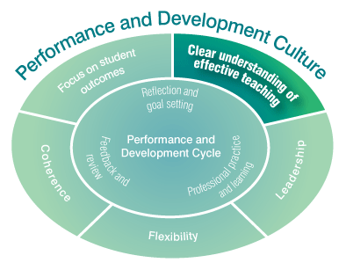
A clear understanding of effective teaching
To focus on improving teaching, it is necessary to have a clear vision of what effective
teaching looks like. The Standards provide the
basis and a common
language for coming to a
shared understanding of
what effective teaching looks
like in the context of a particular school at a particular time.
Notes:
Purpose
To focus on the importance of a clear understanding of effective teaching in the creation of an effective performance and development culture in schools.
Key points to share
A clear understanding of effective teaching – to focus on improving teaching, it is necessary to have a clear vision of what effective teaching looks like. The Australian Professional Standards for Teachers outline what teachers should know and be able to do at four career stages.
These Standards present a comprehensive picture of the elements of effective teaching covering the three domains of Professional Knowledge, Professional Practice and Professional Engagement.
The Standards provide a broad picture of the work of teachers. Schools, and individual teachers within them, are unlikely to be focusing on all areas of the Standards at once. Rather, the Standards should be seen as providing the basis and a common language for coming to a shared understanding of what effective teaching looks like in the context of a particular school at a particular time. This understanding of effective teaching will be shaped by the school’s context and priorities.
Research
‘Teachers report that the greater the emphasis on an aspect of their teaching in the evaluation of their work, the greater the change in what they do in the classroom’ (Jensen, B 2010, p. 24)
Materials required
The Australian Professional Standards for Teachers.

Slide 10
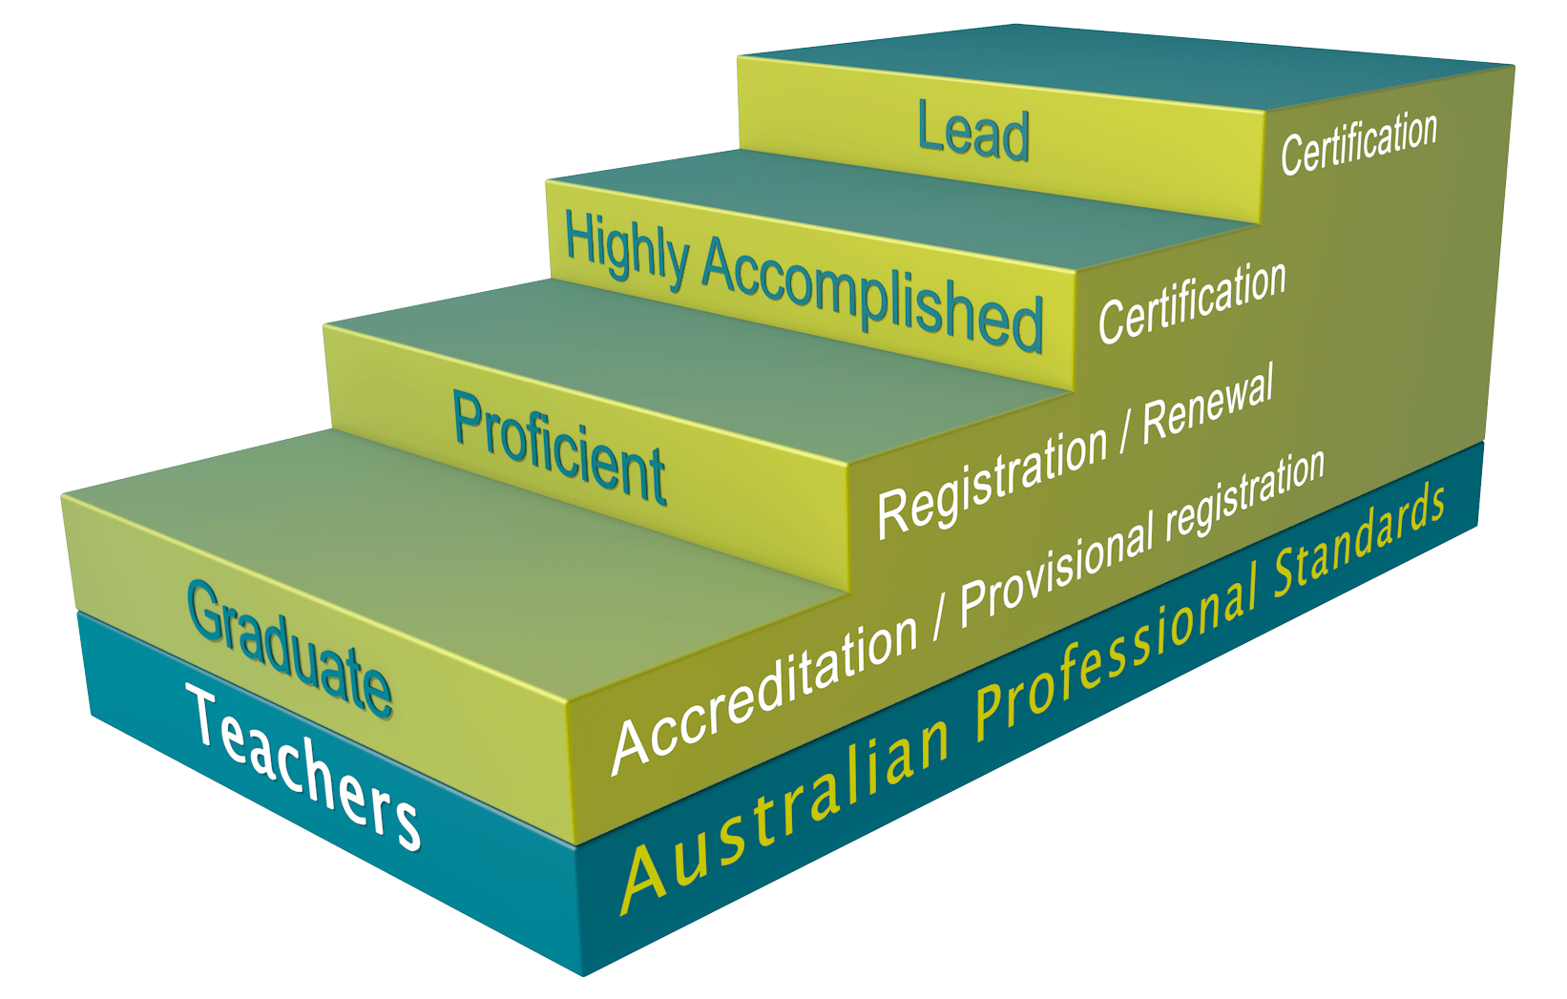
Australian Professional Standards for Teachers
Dual purpose:
Improvement
Career progression
Notes:
Purpose
Have participants understand how the Australian Professional Standards for Teachers align with the Framework.
Key points to share
A performance and development culture requires a clear understanding of effective teaching as outlined in the Australian Professional Standards for Teachers, with a clear focus on improving teaching as the means of improving student outcomes and requires that teachers know what is expected of the and receive frequent feedback and promote genuine professional conversations.
Aims of the Australian Professional Standards for Teachers in use with the Framework:
Assist in self-reflection and self-assessment
Inform the development of performance and professional learning goals
Basis for ongoing informal and formal feedback, including classroom observations
Provide a framework by which teachers can judge the success of their learning
Provide a basis for review of and evidence against the achievement of goals.
The Australian Professional Standards for Teachers outlines what teachers should know and be able to do at four career stages and they provide a common language for coming to a shared understanding of what effective teaching looks like in the context of a particular school:
Four professional career stages:
Graduate – Proficient – Highly Accomplished – Lead.
Three domains:
Professional Knowledge
Professional Practice
Professional Engagement.
The seven Standards for teachers:
Know students and how they learn
Know the content and how to teach it
Plan for and implement effective teaching and learning
Create and maintain supportive and safe learning environments
Assess, provide feedback and report on student learning
Engage in professional learning
Engage professionally with colleagues, parents/carers and the community.
Australian Professional Standards for Teachers
AITSL consulted broadly in the development/finalisation of the Standards.
Endorsed by MCEECDYA in December 2010.
Launched by Ministers in February 2011.
Materials required
The Australian Professional Standards for Teachers.

Slide 11
Teacher Standards animation
Click image to play
Notes:
Purpose
This animation is intended to provide a visual exploration of the Standards and assist participants in responding to the reflective activity that follows.

Slide 12
Activity: What is effective teaching?
Based on the Standards, what are the priorities and fundamental components for effective teaching in your school’s unique context?
How do you share your understanding of effective teaching?
As a teacher, how do you know if your teaching is effective?
Notes:
Purpose
To articulate what effective teaching looks like and how the Australian Professional Standards for Teachers assist in defining this.
Key points to share
The Australian Professional Standards for Teachers outlines what teachers should know and be able to do at four career stages and they provide a common language for coming to a shared understanding of what effective teaching looks like in the context of a particular school.
Expected outcomes
Participants will gain a greater understanding of what effective teaching looks like and be able to articulate what it looks like in their school.
Duration
15 minutes.
Materials required
Activity – What is effective teaching?
(The best size is A3 to allow the facilitator to collate and display ideas from the groups).
The Australian Professional Standards for Teachers.
Instructions
Think, Group, Share.
Work in groups.
With the Standards and your own school context and priorities in mind discuss the three questions below and record your responses on the worksheet provided.
Discuss the three questions and record your responses on the worksheet provided.
After 10 minutes, each group to report back with 3 key points to the whole workshop.

Slide 13
Leadership
Leadership must come from all levels, from those with and without formal leadership positions. Enacting change is a
shared commitment.
Notes:
Purpose
To focus on the role of leadership in creating an effective teacher performance and development culture in schools.
Key points to share
Leadership - research is clear not only on the importance of school leadership in improving school performance, but also on the critical role of leaders in creating a culture of performance and development. The Australian Professional Standard for Principals makes clear the role of the principal in leading teaching and learning, developing him or herself and others, and leading improvement in a school. All these elements are central to a performance and development culture.
While it is acknowledged that principals have a central role, a performance and development culture cannot be driven by one person alone. Leadership must come from all levels, from those with and without formal leadership positions.
A truly effective approach is characterised by a shared commitment to improvement and an acceptance that teachers have a powerful role to play in each others’ development, as well as their own.
Emphasis is on the lead learner role of the Principal and wide spread use of distributed leadership.
Within the Framework, opportunities for shared leadership exist through the roles of delegate, peer observation and feedback, mentoring and coaching.
Principals and other school leaders are entitled to support to implement performance and development in their schools.
Research
‘Accordingly school leaders need to have or develop the confidence and capacity to introduce effective performance and development processes and connect them to the broader school strategies to improve teacher performance and student outcomes’ (Marshall, G et al 2012, p. 7).
‘A good framework and a good system will still fail if not implemented well at a school level. In Hay Group’s view, while there are many elements, the two essential elements of successful implementation and delivering sustainable improvement are leadership and culture’ (Hay Group 2012, p 16).
‘The more leaders focus their influence, their learning, and their relationships with teachers on the core business of teaching and learning, the greater their likely influence on student outcomes’ (Robinson, V 2007, p. 15).
Activity Cards
There are related Activity Cards for the topics in this slide available at aitsl.edu.au

Slide 14
Australian Professional Standard for Principals
The Standard takes into account the crucial contribution made by principals. The role of the leader is critical in creating a culture of performance and development. However, leadership is required from all levels and is a shared commitment.
Notes:
Purpose
To introduce the Australian Professional Standard for Principals (the Standard) and explore how this aligns with the Framework.
Key points to share
The Standard acknowledges the challenging and changing context in which principals work and the diverse settings and variety of situations which the face on a day-to-day basis. The Standard provides a model against which principals can match their knowledge, qualities, experiences and skills to determine their strengths and areas for development.
It is ‘The Standard’ rather than ‘Standards’, as it is integrated by nature reflecting the complexity of the role and shared ideals. The Standard is applicable to principals irrespective of context or experience. What will vary is the emphasis given to particular elements of the Standard as principals respond to context, expertise and career stage.
The Standard for Principals takes into account the crucial contribution made by principals:
Raising student achievement at all levels and all stages.
Promoting equity and excellence.
Creating and sustaining the conditions under which influencing, developing and delivering community expectations and government policy quality teaching and learning thrive.
Contributing to the development of a 21st century education system at local, national and international levels.
Research
‘“…nearly 60% of a school’s impact on student achievement is attributable to principal and teacher effectiveness. These are the most important in-school factors driving school success, with principals accounting for 25% and teachers 33% of a school’s total impact on achievement.” This statement may even understate the potential impact of effective school leadership, because leadership is itself one of the main drivers of the quality of teaching’ (Barber, M et al 2010, p. 5).
Materials required
The Australian Professional Standard for Principals.

Slide 15
“School leadership supports performance and development within the school. But I see a performance and development culture in the school really supporting teachers to become leaders…”
Kathryn Hudson, Principal
St Peter’s Catholic Parish Primary School, VIC
Notes:
Purpose
To further emphasise the notion of shared leadership within the Framework.
Key points to share
The most critical part of ensuring successful implementation of any performance management, development and improvement process is the leadership and people management of an organisation. A leader with the right competencies can make a performance framework and process work through the way they conduct performance conversations and the emphasis they put on development so that they help the teacher feel stronger and more capable (Hay Group 2012, p. 17).
Activity Cards
There are related Activity Cards for the topics in this slide available at aitsl.edu.au

Slide 16
Activity: Leadership as a shared responsibility
What is the responsibility of school leaders in developing a performance and development culture?
What is the responsibility of teachers in developing a performance and development culture?
What does it look like when school leaders and teachers collaborate around leadership of cultural change?
Notes:
Purpose
To articulate what leadership looks like in schools.
Expected outcomes
Participants will gain a greater understanding of what shared leadership looks like and be able to articulate what it looks like in their school.
Duration
15 minutes.
Materials required
Activity sheet – Leadership as a shared responsibility
(The best size is A3 to allow the facilitator to collate and display ideas from the groups).
Instructions
Think, Group, Share.
Work in groups.
Discuss the three questions on the slide and record your responses on the worksheet provided.
As a whole group, discuss your reflections.

Slide 17
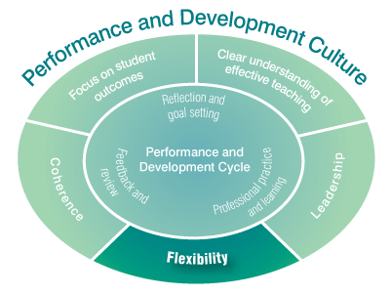
Flexibility
All schools are different, and need to respond to
their unique contexts and histories.
Notes:
Purpose
To gain an understanding of what is meant by flexibility within an effective culture of performance and development.
Key points to share
Flexibility - All schools are different, and need to respond to their unique contexts and histories. Schools vary widely in their existing approaches to teacher performance and development. It is clear that effective implementation takes into account starting points, and that the sequencing of change will be different in different situations.
This Framework describes the elements of an effective approach to teacher performance and development, but acknowledges that these elements will look different in each school.
All schools have unique contexts and histories and each school will be a different stages in their approach to performance and development processes, with starting points and the sequence of change varying.

Slide 18
Activity: What is unique about your school?
History
Context
Current and past initiatives
Identify your starting point or next steps in improving effective performance and development practices in your school.
Notes:
Purpose
To focus on the concept of flexibility within the Framework by looking at where performance and development sits within participants’ current school based programs, policies and strategic direction.
Key points to share
This activity familiarises participants with where they are in their performance and development journey.
Expected outcomes
The participants will have a shared view of what the current context is of performance and development culture within their school.
Duration
15 minutes.
Materials required
Activity – What is unique about your school
(The best size is A3 to allow the facilitator to collate and display ideas from the groups).
Instructions
Think, Group, Share.
Work in groups.
With your own school context, history, and current and past initiatives in mind, identify your staring point and/or next steps in improving performance and development practices in your school.
Groups to record responses on the worksheet provided and appoint a spokesperson to share the group’s insights.
Facilitator records insights.

Slide 19
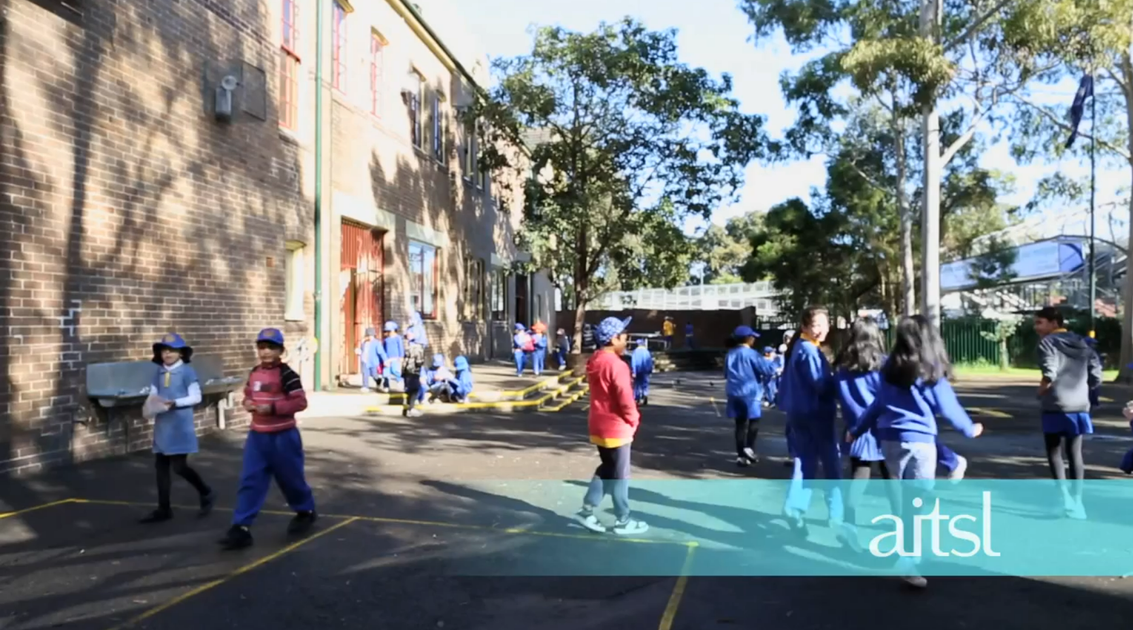
Effective performance and development practices
Click image to play
Lakemba Public School, NSW
Notes:
Purpose
To focus on an example of existing performance and development processes in an Australian school.
Key points to share
Over the last six years Lakemba Public School has worked assiduously to build on their performance and development processes, to build the professional capacity of the teachers and to improve student outcomes.
In addition to utilising the services of a principal mentor the school has restructured the roles of the executive group taking them off class so that they can support the professional development of teachers, established stage related teams, scheduled fortnightly professional development sessions for all teachers, and introduced a lesson study focus.
When viewing the video, please note that Lakemba Public School received additional funding to enable the restructure of their processes. It is understood that the majority of schools will not have access to this funding but it is important to note that Lakemba will be restructuring and continuing with changes when funding ceases due to the positive impact this is having on the teaching practices in the school.
Materials required
View the video.
Read the Case Study – Lakemba Public School, NSW.

Slide 20
Activity: Impact / Achievability Matrix
Work in groups
Each person in turn is to place the ten cards in their chosen square for their school at this time. Take time to explain the reason/s for your choice
Together reflect on what you have learnt about your school’s/organisation’s current structures recording any insights
Notes:
Purpose
To focus on the school’s ability to implement a particular strategy and the impact that the implementation of the strategy would have on the participants’ school.
Materials required
Activity – Impact/Achievability matrix
Activity – Impact/Achievability matrix cards
10 cards identifying effective performance and development practice and 6 spare blank cards.
Activity – Quadrant insights.
Instructions
It will be important to follow the task steps closely.
In particular encourage the person placing the cards to take the time to explain the reasoning behind where and why they have placed the card in that position on the Matrix.
Think, group, share activity.
Work in groups.
Each person in turn is to place the ten cards in their chosen square for their school at this time. Take time to explain the reason/s for your choice.
Together reflect on what you have learnt about your school’s/organisation’s current structures recording any insights.
Each group is to appoint a spokesperson to share the group’s insights.
Facilitator records insights.

Slide 21
Activity: Impact / Achievability Matrix
High
2
1
Impact
3
4
Low
Low
Achievability
High
Notes:
Purpose
To focus on the school’s ability to implement a particular strategy and at the same time the impact that the implementation of the strategy would have on the participants’ school.
Key points to share
This activity will support the identification of future initiatives.
Expected outcomes
The participants will have a shared view of where changes could be made within their existing processes and structures.
The participants may identify future initiatives or programs for which they see a possibility for.
Duration
15 minutes.
Materials required
See previous slide.
Instructions
See previous slide.

Slide 22
Coherence
Performance and development processes should align with school, system and national current plans, processes
and initiatives.
Notes:
Purpose
To gain an understanding of what is meant by coherence in creating a culture of effective teacher performance and development.
Key points to share
Coherence – it is important that performance and development processes in a school fit with other arrangements in which schools, teachers and school leaders are involved.
Performance and development processes and teacher goals should reflect the overall approach to teaching and learning within a school, and should be consistent with the school's plans.
It is important that teachers and school leaders experience performance and development as something that ties together the various activities they are engaged in, rather than a separate and additional process. Alignment to school plans and school-wide approaches to professional learning are particularly important.
Effective performance and development processes are consistent with the school, system and national plans and tie together the various activities the in which the school is engaged.

Slide 23
Activity: Achieving coherence
How do you intend to tackle the challenge of aligning the practices outlined in the performance and development Framework to your existing school arrangements?
Notes:
Purpose
To focus on what existing processes and plans align with the performance and development Framework.
Key points to share
It is important that performance and development processes in a school fit with other arrangements in which schools, teachers and school leaders are involved.
Alignment to school plans and school-wide approaches to professional learning are particularly important.
Coherence with other national initiatives is also important:
Registration and renewal of registration
Certification
Professional learning plans
School plans
System initiatives.
Expected outcomes
Participants will have a shared view of where performance and development sits as a priority at their school.
Duration
10 minutes.
Materials required
Activity – Achieving coherence worksheet from the Facilitators pack.
(The best size is A3 to allow the facilitator to collate and display ideas from the groups).
Instructions
Think, Group, Share.
Work in groups.
With your own school context and priorities in mind as well as your current performance and development processes, discuss the activity question and record your responses as small action steps on the worksheet provided.
Each group is to appoint a spokesperson to share the group’s insights.
Facilitator records insights.

Slide 24
“Everything we do here is based on improving our performance, both of the students and the staff and myself too. So everything is about performance and development the whole way through.”
Kevin Mackay, Principal
Dandenong North Primary School, VIC
Notes:
Purpose
To highlight the importance of performance and development processes being coherent with the other arrangements and processes within schools.

Slide 25
The Framework animation
Click image to play
Notes:
Purpose
To provide a summary to the Framework in a visually engaging way, providing participants with an overview of its key features and a context in which to understand the Framework.
Key points to share
As discussed in the introduction (slide 1) AITSL has collaborated with education stakeholders to develop the Australian Teacher Performance and Development Framework. The Framework has been developed based on research, national mapping and analysis of existing practices, advice from national and international experts, and national consultation.
Materials required
The Framework Discussion Wheel – printable desktop stimulus resource
The Framework Fact Sheet – Animation style
The Framework Infographic – Animation style

Slide 26
Notes:
Purpose
To refocus participants on why we as a nation are focusing on improving the teaching profession.
Key message
Changing and building culture requires a shared commitment and sustained effort.
Improving teacher quality through a performance and development culture is important work that is worth doing. It is also a collective responsibility. The next step is for all involved in Australian education to take a deliberate, structured and long-term approach to building a culture that provides a satisfying and challenging environment in which all Australian teachers can improve their practice and the outcomes their students achieve.

Slide 27
Connecting with AITSL
aitsl.edu.au
newsroom.aitsl.edu.au
performance@aitsl.edu.au
@aitsl
youtube.com/aitsleduau
iTunes U > Australian Institute for Teaching and School Leadership
www.facebook.com/aitsl
@
Notes:
Purpose
Social media is becoming an effective medium to connect, share and collaborate with educators within Australia and all over the world through professional learning networks (PLNs) and communities of practice.
References
Barber, M, Whelan, F & Clark, M 2010, Capturing the leadership premium: How the world's top school systems are building leadership capacity for the future, McKinsey, London, viewed 30 November 2012, <http://mckinseyonsociety.com/downloads/reports/Education/schoolleadership_final.pdf>.
Hay Group 2012, Growing our potential: Hay Group’s view on implementing an effective performance improvement and development framework for teachers, Independent paper prepared for AITSL, Melbourne, viewed 30 November 2012, <http://www.haygroup.com/Downloads/au/misc/Growing_our_potential_singles.pdf>.
Jensen, B & Reichl, J 2011, Better teacher appraisal and feedback: Improving performance, Grattan Institute, Melbourne, viewed 30 November 2012, <http://grattan.edu.au/static/files/assets/a9daf733/081_report_teacher_appraisal.pdf>.
Jensen, B 2010, What teachers want: Better teacher management, Grattan Institute, Melbourne, viewed 30 November 2012, <http://grattan.edu.au/static/files/assets/1cc095c7/033_report_what_teachers_want.pdf>.
Kamener, L, Boston Consulting Group 2012, Delivering real change in the approach to performance and development in schools, independent submission to AITSL, viewed 30 November 2012, <http://www.aitsl.edu.au/verve/_resources/BCG_Schools_Delivering_Real_Change.pdf>.
Marshall, G, Cole, P & Zbar, V 2012, Teacher performance and development in Australia: A mapping and analysis of current practice, AITSL, Melbourne.
MCEETYA 2008, Melbourne Declaration on Educational Goals for Young Australians, Ministerial Council on Education, Employment, Training and Youth Affairs, Melbourne.
Robinson, V 2007. ‘The impact of leadership on student outcomes: Making sense of the evidence’, Research Conference 2007, Australian Council for Educational Research, Melbourne, Australia viewed 30 November 2012, pp. 12-16.

